Slide 1
3. Sensory Considerations for Learners with Visual & Hearing Loss, Multisensory Learning
3E: Implications of Hearing Conditions for Learning
www.multisensorylearning.lgfl.net ©2018 www.hirstwood.com & London Grid for Learning

Slide 2
Strategies to support learners with hearing conditions include:
Position the learner so they are close to the instruction
www.multisensorylearning.lgfl.net ©2018 www.hirstwood.com & London Grid for Learning

Slide 3
Strategies to support learners with hearing conditions include:
Gain the learners attention & eye contact before speaking
www.multisensorylearning.lgfl.net ©2018 www.hirstwood.com & London Grid for Learning

Slide 4
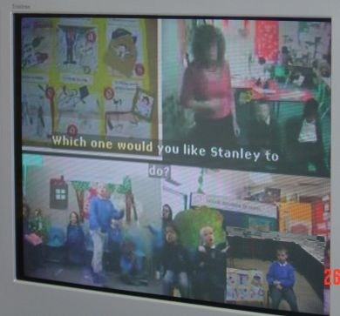
Strategies to support learners with hearing conditions include:
Use short sentences
If the child uses sign language, remember to sign everything, not just when you are speaking to that child.
www.multisensorylearning.lgfl.net ©2018 www.hirstwood.com & London Grid for Learning

Slide 5
Strategies to support learners with hearing conditions include:
Use facial expression & body language to reinforce speech
www.multisensorylearning.lgfl.net ©2018 www.hirstwood.com & London Grid for Learning

Slide 6
Strategies to support learners with hearing conditions include:
Give the learner the opportunity/strategy to check their understanding - ask for a repetition of instructions/question etc.
www.multisensorylearning.lgfl.net ©2018 www.hirstwood.com & London Grid for Learning

Slide 7
Strategies to support learners with hearing conditions include:
Use visual cues to support the spoken word i.e. pictures, symbols, written word, signs.
www.multisensorylearning.lgfl.net ©2018 www.hirstwood.com & London Grid for Learning

Slide 8
Strategies to support learners with hearing conditions include:
Be aware of concentration fatigue
Reduce background noise - close the classroom door, use soft furnishings/carpet to reduce classroom noise.
Is the learner positioned in a way so that they can see their peers during a lesson or learning activity?
www.multisensorylearning.lgfl.net ©2018 www.hirstwood.com & London Grid for Learning

Slide 9
The functional effects of a hearing condition on learning
Here is a simple guide to functional effects of hearing loss and what this means for the learner in your classroom.
A learner may experience difficulty with:
Understanding and using more abstract words (before/shy/same as) but use concrete words successfully (jump/red/two)
Understanding multiple meanings of the same word i.e. bark - the noise a dog makes or the outside of a tree trunk?
www.multisensorylearning.lgfl.net ©2018 www.hirstwood.com & London Grid for Learning

Slide 10
The functional effects of a hearing condition on learning
Sentence formation - particularly understanding and using longer, complex sentences
Saying sounds correctly, especially quieter ones such as s/f/sh
Contributing to and keeping up with class discussion, as their self-confidence may be poor and the increased effort involved in hearing and processing a fast moving discussion will produce fatigue
www.multisensorylearning.lgfl.net ©2018 www.hirstwood.com & London Grid for Learning

Slide 11
The functional effects of a hearing condition on learning
Poor behaviour - not being able to follow what is happening in class/verbal instructions can lead to distraction/poor concentration & reduced engagement
Inappropriate answers to questions - indicating a learner’s difficulty in following the class discussion fully
Frustration/Peer isolation/lack of friendship groups
www.multisensorylearning.lgfl.net ©2018 www.hirstwood.com & London Grid for Learning

